Slide 1
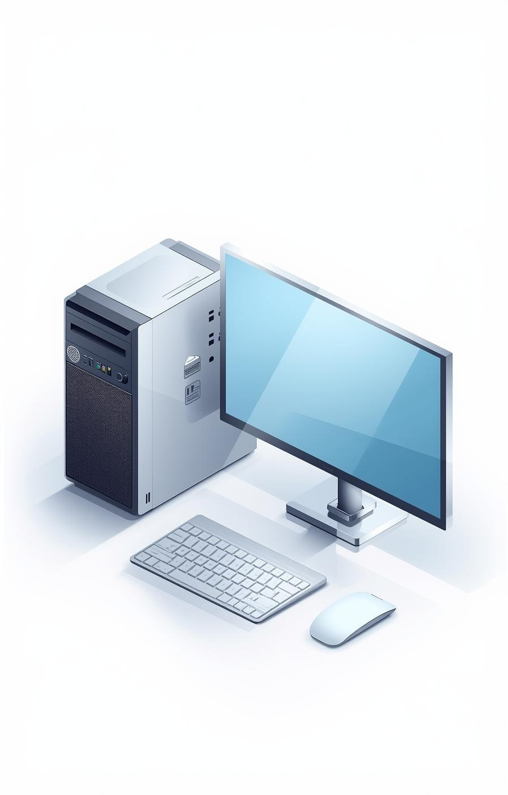

Computer Case, Monitor, and Keyboard
Presented by [Hana Aden]

Slide 2
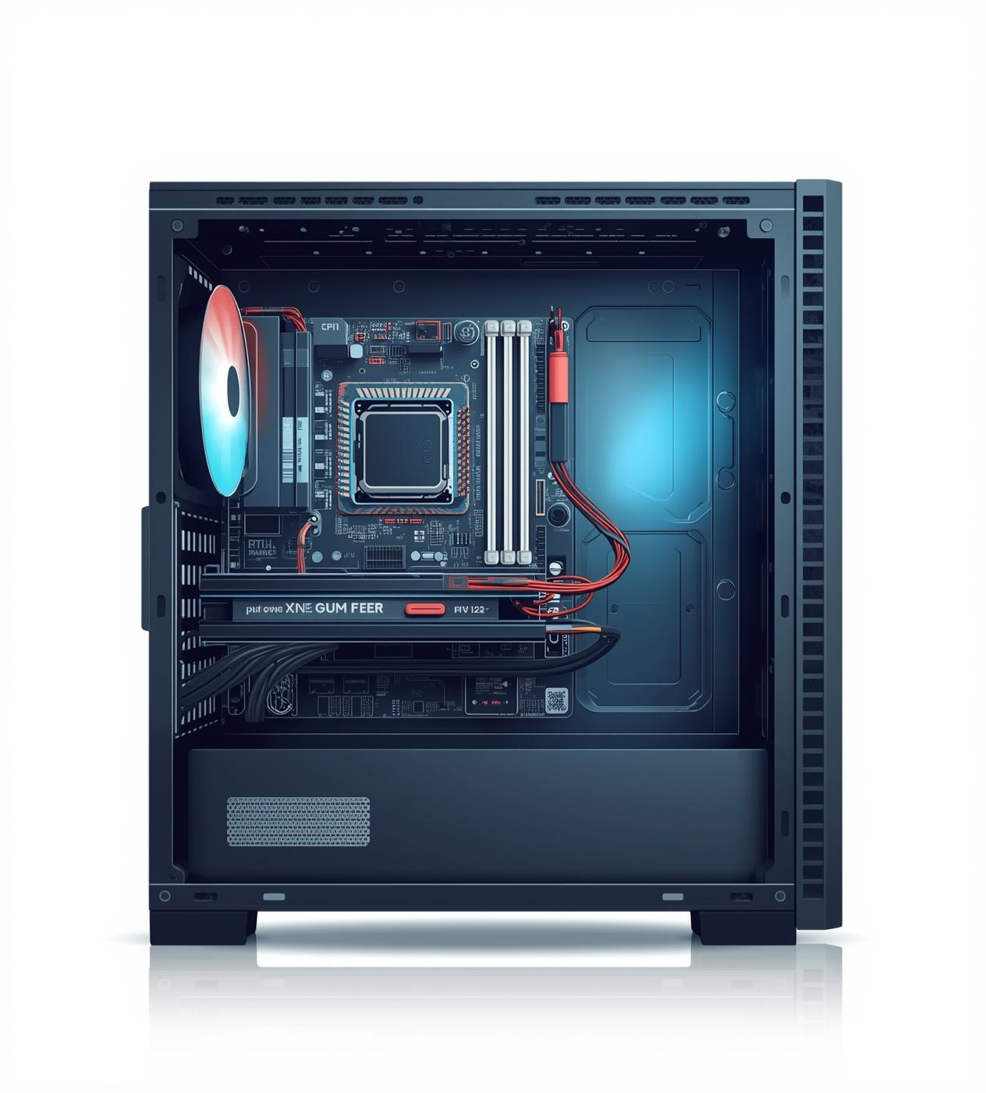
Protecting and Organizing Hardware
The computer case serves as the essential housing for vital components like the motherboard, CPU, and power supply, ensuring protection from external damage while enabling efficient organization of hardware for optimal performance.

Slide 3

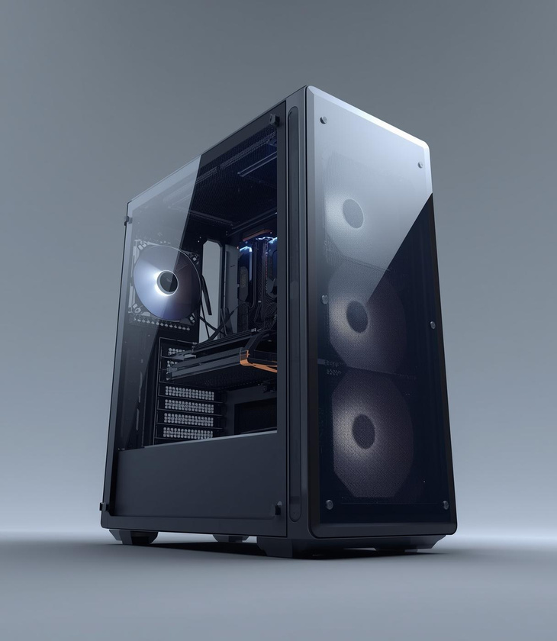
Front Panel Features and Case Types

Slide 4
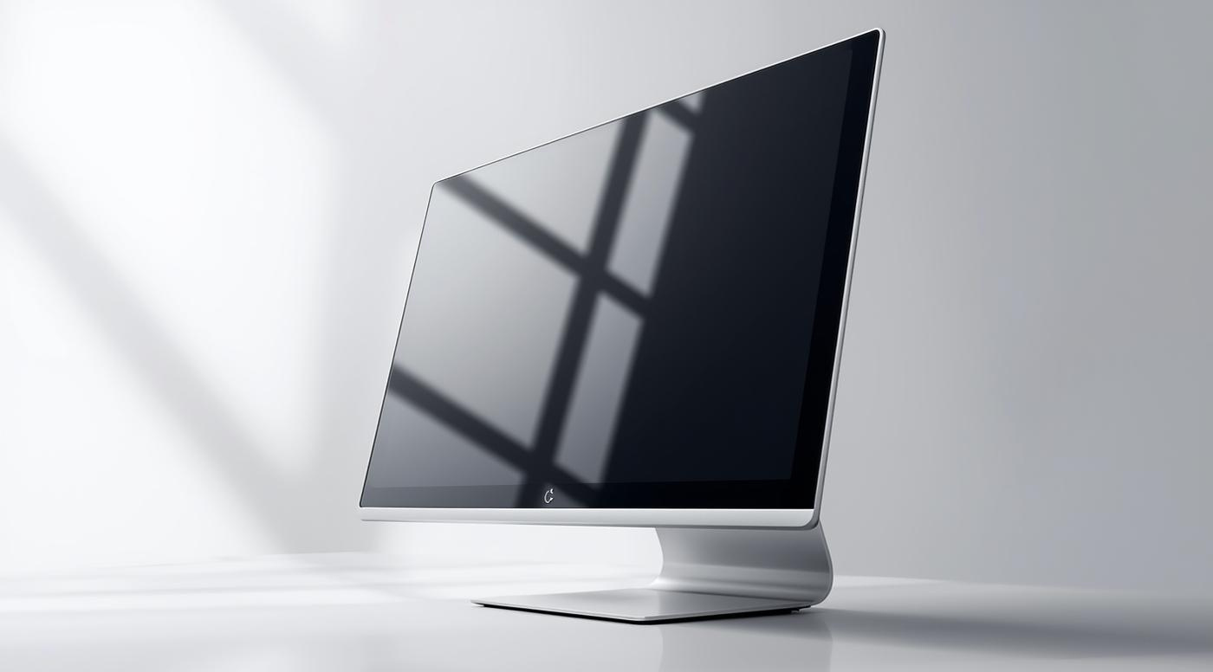
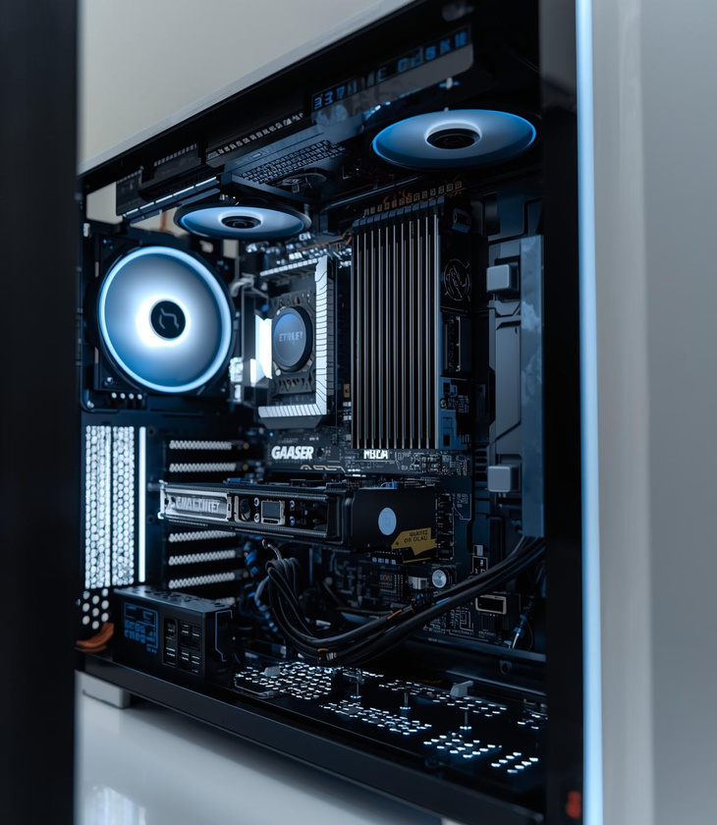
All-in-One Computer Case Design

Slide 5
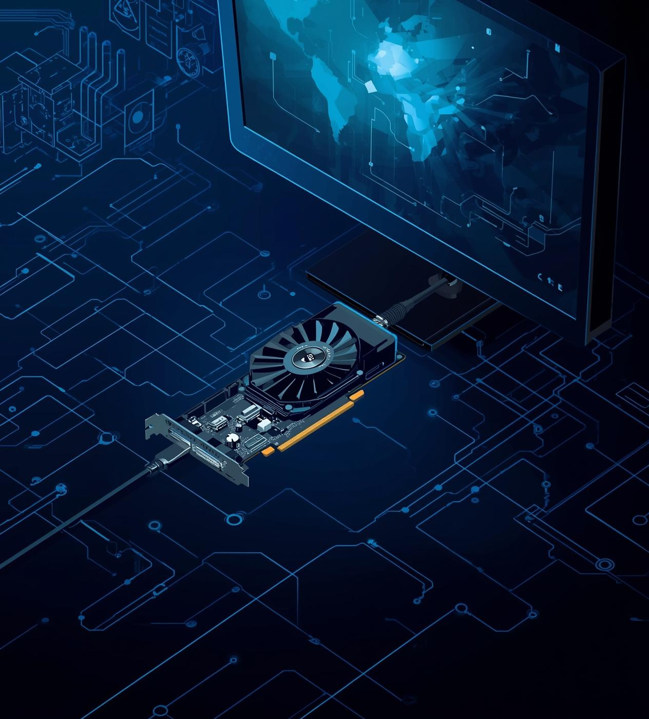
Monitor Functions and Types
Monitors display images and text by connecting to the internal video card, showcasing various outputs and allowing users to interact with their computers through vibrant visuals and responsive control buttons.

Slide 6
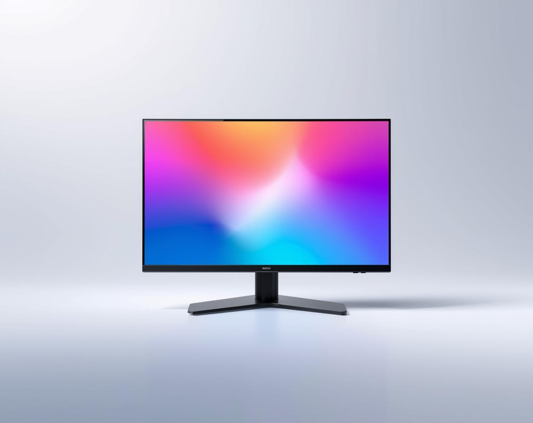
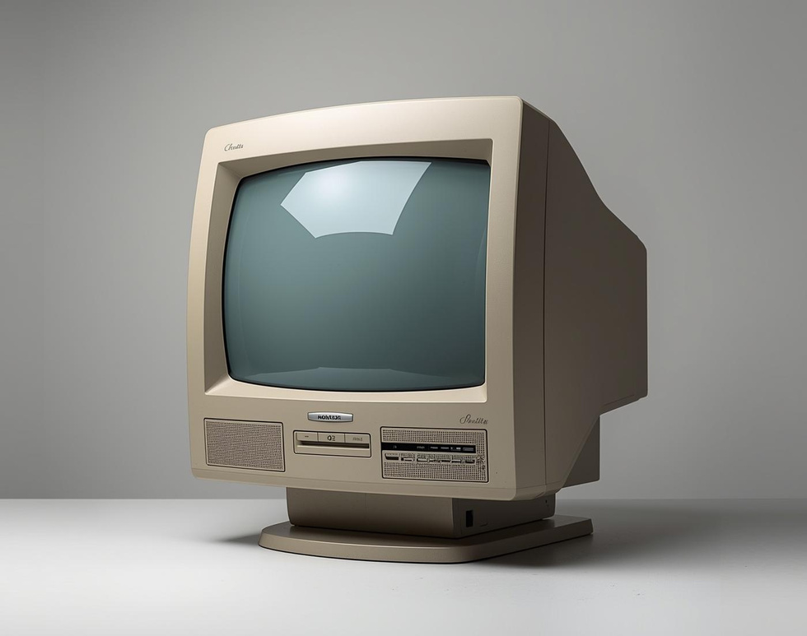
LCD/LED vs. CRT Monitors
Comparing Modern and Older Technologies

Slide 7
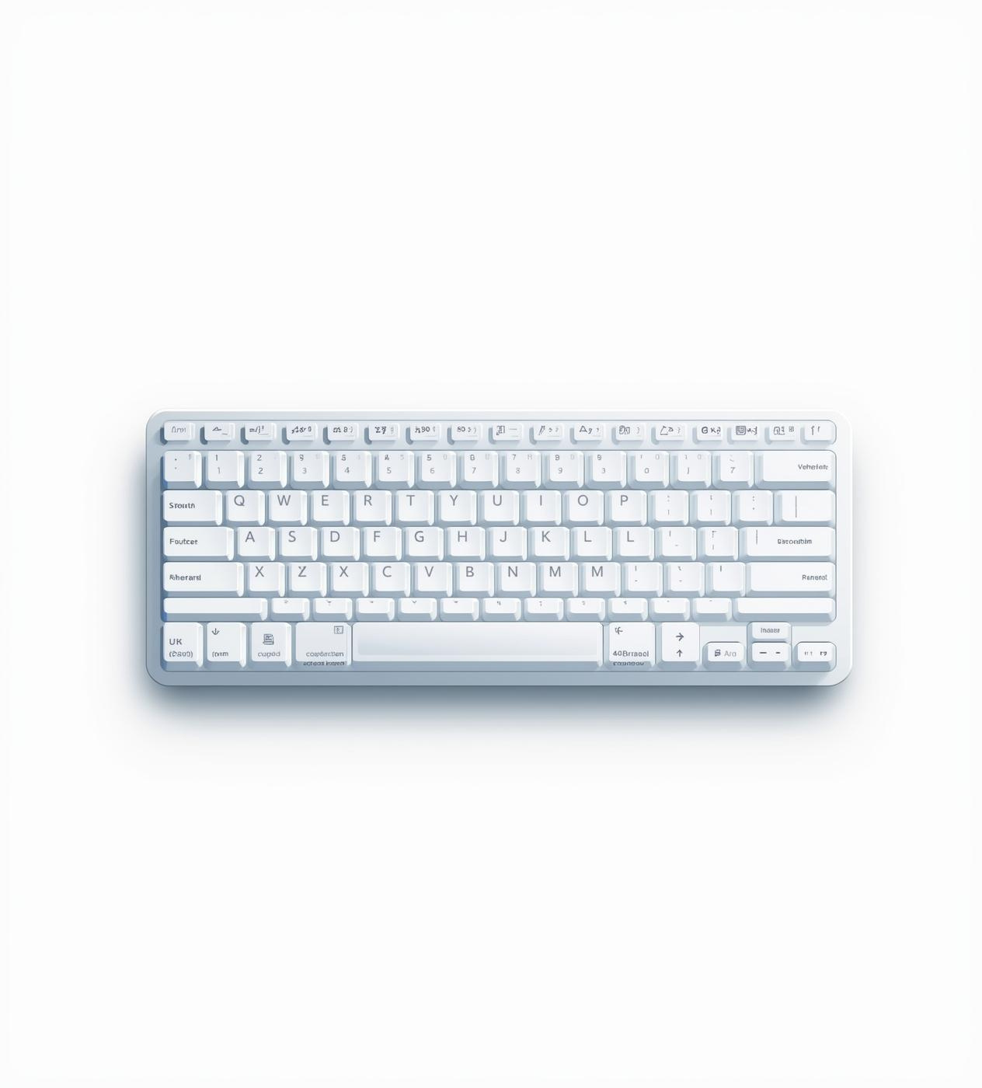
Keyboard Structure and Key Functions
The keyboard is the primary input device for computers, facilitating communication through various key groups, including alphanumeric, function, control, navigation, and special keys, essential for efficient computer operation.

Slide 8
Keyboard Key Groups
Understanding alphanumeric, function, and control keys
Alphanumeric Keys
Function Keys
Control Keys
Alphanumeric keys include letters and numbers, enabling text entry for documents and communication, essential for typing and inputting data in various applications.
Function keys (F1-F12) provide shortcuts for specific tasks within software, enhancing productivity by allowing users to quickly access functions like help and menu navigation.
Control keys such as Ctrl, Alt, and Shift are used in combination with other keys to execute commands, significantly improving efficiency in document editing and software operations.
8

Slide 9
Navigation and Special Keys
Understanding keyboard functions and layout
Navigation Keys
Special Function Keys
Numeric Keypad
Navigation keys include arrow keys and Page Up/Down, assisting users in moving the cursor and navigating documents efficiently, making them essential for effective computer interaction.
Special keys like Escape and Print Screen serve unique functions, allowing users to stop actions or capture screen content, enhancing versatility during computer use and multitasking.
The numeric keypad simplifies numerical data entry and calculations, resembling a calculator layout, and is beneficial for tasks requiring frequent numerical input, boosting productivity and efficiency.
9

Slide 10

Numeric Keypad Functionality Explained
The numeric keypad allows for quick and efficient number entry, featuring a layout similar to a calculator. It streamlines data input and is especially useful for accounting and data analysis tasks.

Slide 11

Understanding Tab and Insert Keys
The Tab key is crucial for indenting text and navigating between fields, while the Insert key toggles between insert and overtype modes, enhancing text editing efficiency in various applications.

Slide 12

Lesser-Known Keyboard Keys Explained
The Scroll Lock and Pause/Break keys are often overlooked today. While they served specific purposes in the past, their use has diminished significantly in modern computing environments.

Slide 13

Understanding the Computer Mouse
The mouse is a vital input device enabling users to navigate and interact with their computers. It allows for precise control and selection of objects on the screen, enhancing user experience.

Slide 14

Alternatives to Traditional Mouse
Touchpads provide a space-saving solution for navigation, allowing users to control the cursor with finger gestures. They are commonly found on laptops, offering convenience without additional desk clutter.

Slide 15
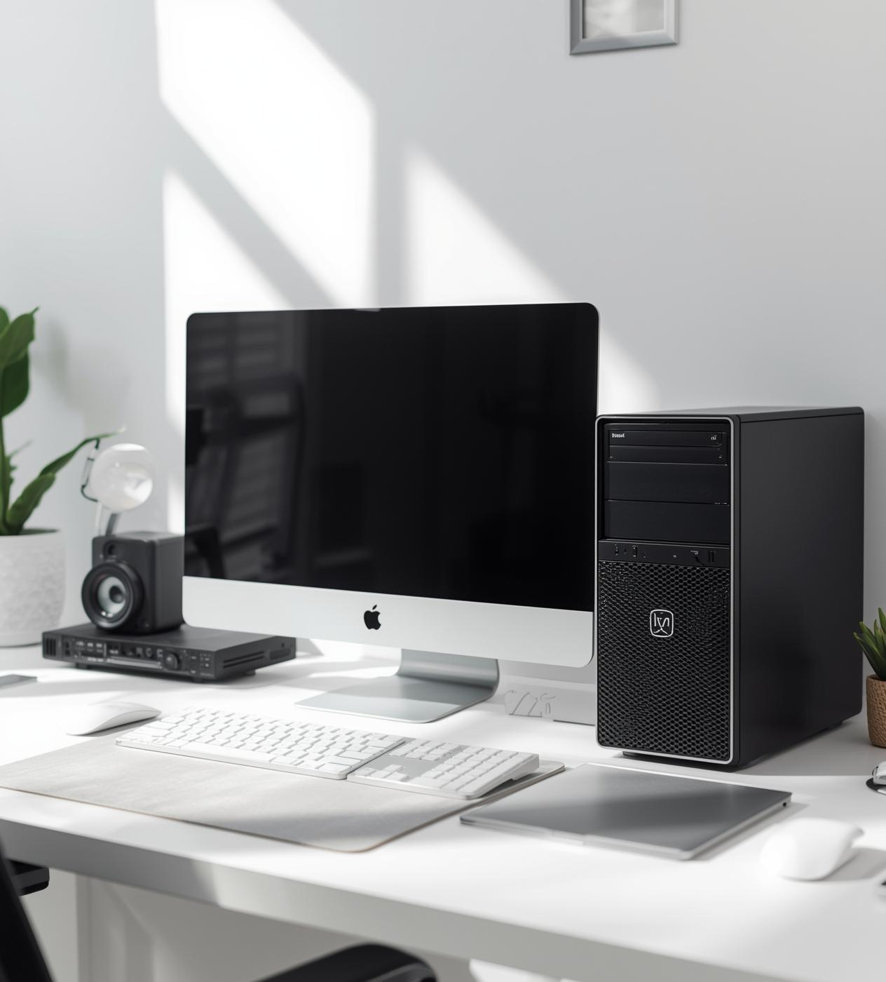
Key Functions and Practical Tips
Understanding the essential roles of the computer case, monitor, and keyboard helps users maximize their efficiency. Choose the right components for your needs and maintain them for optimal performance.

Slide 16

Enhancing Your Monitor and Keyboard Skills
Adjusting monitor settings improves visual comfort. Learning keyboard shortcuts increases efficiency, allowing quick access to commands and functions. Embrace these tools to enhance your overall computing experience and productivity.

Slide 17


Conclusion
Explore hardware and practice skills

